Slide 1

CSE- 321
Software Engineering
Lecture: 06 Software Processes (cont.)
Fahad Ahmed
Lecturer, Dept. of CSE
E-mail: fahadahmed@uap-bd.edu

Slide 2
Lecture Outlines
Rapid application development model
Spiral Model
Incremental Model
V-Model

Slide 3
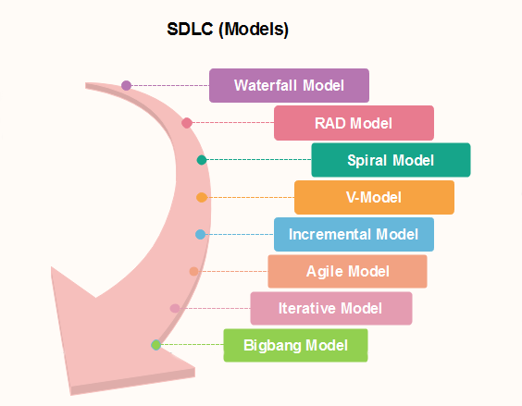
Popular SDLC models

Slide 4
Rapid application development model (RAD)
Rapid application development model (RAD) is a linear sequential software development process model that emphasizes a concise development cycle using an element based construction approach.
Rapid Application Development process is an adoption of the waterfall model, it targets at developing software in a short span of time.
RAD model has following phases
Business Modeling
Data Modeling
Process Modeling
Application Generation
Testing and Turnover
https://www.guru99.com/what-is-rad-rapid-software-development-model-advantages-disadvantages.html

Slide 5
Rapid application development model (RAD)
1.Business Modelling: The information flow among business functions is defined by answering questions like what data drives the business process, what data is generated, who generates it, where does the information go, who process it and so on.
2. Data Modelling: The data collected from business modeling is refined into a set of data objects (entities) that are needed to support the business. The attributes (character of each entity) are identified, and the relation between these data objects (entities) is defined.
3. Process Modelling: The information object defined in the data modeling phase are transformed to achieve the data flow necessary to implement a business function. Processing descriptions are created for adding, modifying, deleting, or retrieving a data object.
4. Application Generation: Automated tools are used to facilitate construction of the software; even they use the fourth-generation language (4GL) technologies.
5. Testing & Turnover: Many of the programming components have already been tested since RAD emphasis reuse. This reduces the overall testing time. But the new part must be tested, and all interfaces must be fully exercised.

Slide 6
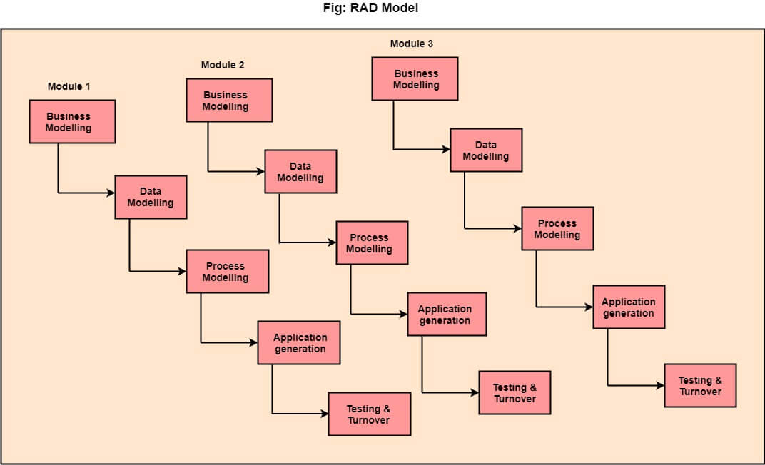
Rapid application development model (RAD)
https://www.javatpoint.com/software-engineering-rapid-application-development-model

Slide 7
Rapid application development model (RAD)
When to use RAD Model?
When the system should need to create the project that modularizes in a short span time (2-3 months).
It is also suitable for projects where requirements can be modularized and reusable components are also available for development.
The model can also be used when already existing system components can be used in developing a new system with minimum changes.
This model can only be used if the teams consist of domain experts. This is because relevant knowledge and ability to use powerful techniques is a necessity.
The model should be chosen when the budget permits the use of automated tools and techniques required.

Slide 8
Rapid application development model (RAD)
Advantage of RAD Model
Use of reusable components helps to reduce the cycle time of the project.
Feedback from the customer is available at initial stages.
Reduced costs as fewer developers are required.
Use of powerful development tools results in better quality products in comparatively shorter time spans.
The progress and development of the project can be measured through the various stages.
It is easier to accommodate changing requirements due to the short iteration time spans.
Disadvantage of RAD Model
It required highly skilled designers.
All application is not compatible with RAD.
For smaller projects, we cannot use the RAD model.
On the high technical risk, it's not suitable.
Required user involvement.

Slide 9
Spiral Model
What is Spiral Model?
Each phase in spiral model begins with a design goal (review) and ends with the client reviewing the progress. The spiral model was first mentioned by Barry Boehm in his 1986 paper.
It implements the potential for rapid development of new versions of the software.
The development team in Spiral-SDLC model starts with a small set of requirement and goes through each development phase for those set of requirements.
The software engineering team adds functionality for the additional requirement in every-increasing spirals until the application is ready for the production phase.

Slide 10
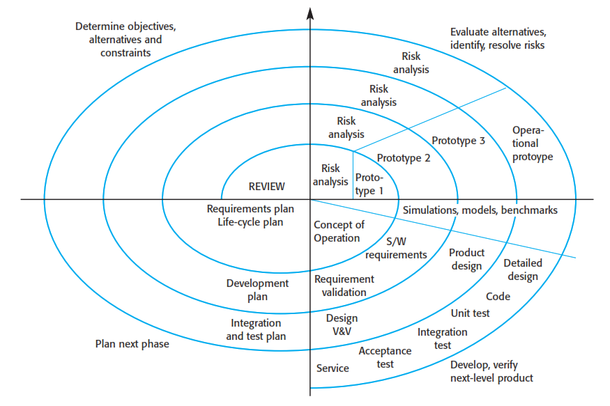
Spiral Model

Slide 11
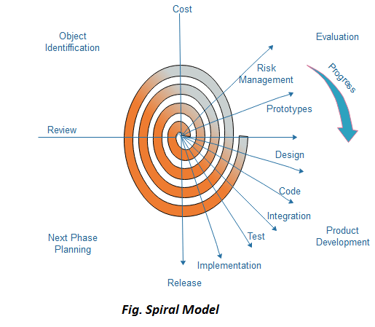
Spiral Model

Slide 12
Spiral Model Sectors
Spiral Model Sectors
Objective setting
Specific objectives for the phase are identified.
Risk assessment and reduction
Risks are assessed and activities put in place to reduce the key risks.
Development and validation
A development model for the system is chosen which can be any of the generic models.
Planning
The project is reviewed and the next phase of the spiral is planned.
Why Spiral Model is called Meta Model ?
The Spiral model is called as a Meta Model because it subsumes all the other SDLC models.
https://www.javatpoint.com/software-engineering-spiral-model
https://www.geeksforgeeks.org/software-engineering-spiral-model/

Slide 13
Spiral Model
When to use Spiral Model?
When deliverance is required to be frequent.
When the project is large
When requirements are unclear and complex
When changes may require at any time
Large and high budget projects
Advantages
Risk Handling
Good for large projects
Flexibility in Requirements
Customer Satisfaction
Disadvantages
Complex
Expensive
Too much dependable on Risk Analysis
Difficulty in time management
https://www.javatpoint.com/software-engineering-spiral-model

Slide 14
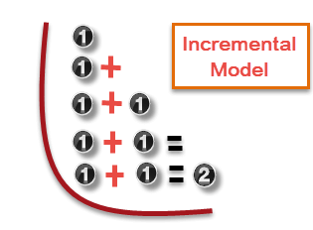
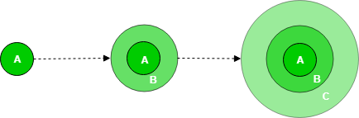
Incremental Model
Incremental process model is also know as Successive version model.
First, a simple working system implementing only a few basic features is built and then that is delivered to the customer. Then thereafter many successive iterations/ versions are implemented and delivered to the customer until the desired system is released.
Incremental Model is a process of software development where requirements are broken down into multiple standalone modules of software development cycle.

Slide 15
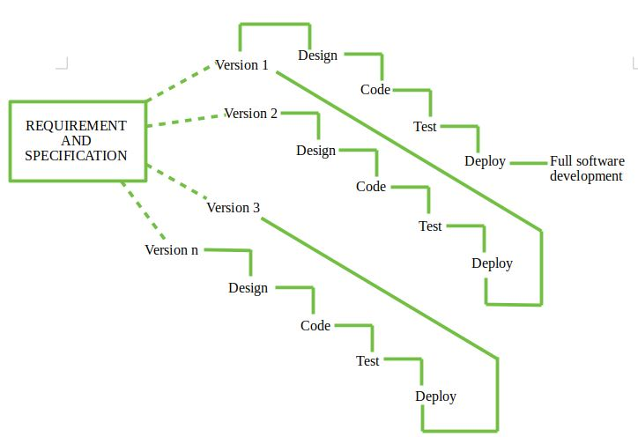
Incremental Model

Slide 16
Incremental Model
Types of Incremental model –
Staged Delivery Model –
Construction of only one part of the project at a time.
Parallel Development Model –
Different subsystems are developed at the same time. It can decrease the calendar time needed for the development, i.e. TTM (Time to Market), if enough Resources are available.
https://www.geeksforgeeks.org/software-engineering-incremental-process-model/

Slide 17
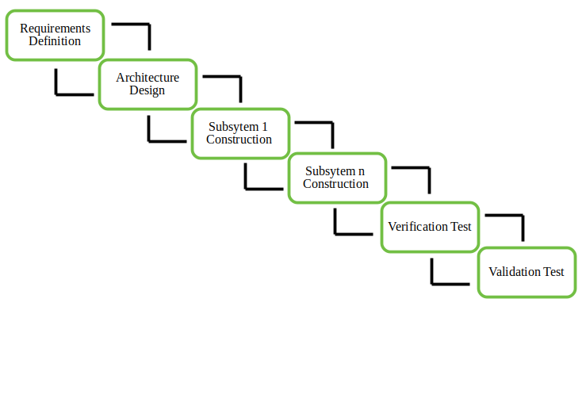
Incremental Model
Staged Delivery Model –
https://www.geeksforgeeks.org/software-engineering-incremental-process-model/

Slide 18
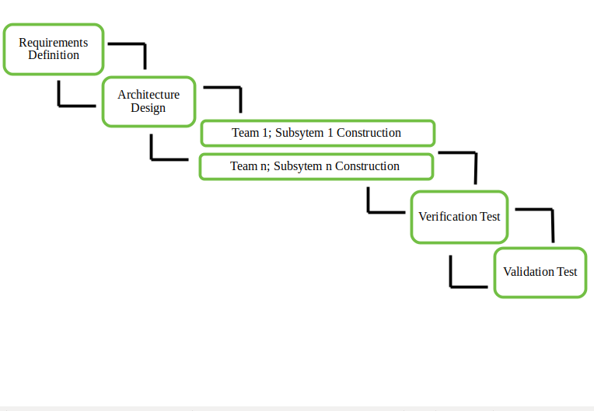
Incremental Model
Parallel Development Model –
https://www.geeksforgeeks.org/software-engineering-incremental-process-model/

Slide 19
Incremental Model
When we use the Incremental Model?
Funding Schedule, Risk, Program Complexity, or need for early realization of benefits.
When Requirements are known up-front.
When Projects having lengthy developments schedules.
Projects with new Technology.
Advantage
Errors are easy to be recognized.
Easier to test and debug
More flexible.
Simple to manage risk because it handled during its iteration.
The Client gets important functionality early.
Disadvantage
Need for good planning
Total Cost is high.
Well defined module interfaces are needed.

Slide 20
V-Model
The left side of the model is Software Development Life Cycle - SDLC
The right side of the model is Software Test Life Cycle - STLC
The entire figure looks like a V, hence the name V – model
V-Model referred to as the Verification and Validation Model.
Process executes in a sequential manner in V-shape.
It is based on the association of a testing phase for each corresponding development stage. Development of each step directly associated with the testing phase.
The next phase starts only after completion of the previous phase.

Slide 21
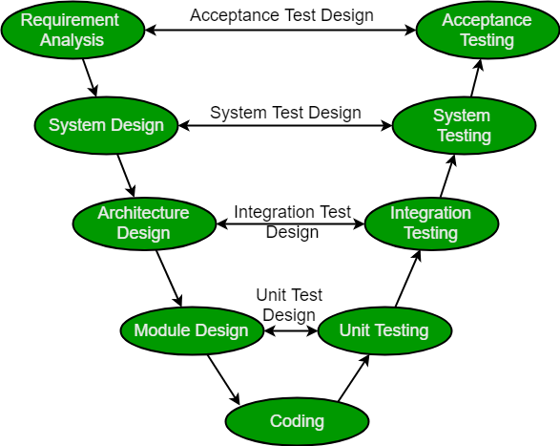
V-Model
https://www.geeksforgeeks.org/software-engineering-sdlc-v-model/

Slide 22
V-Model
Design Phase:
Requirement Analysis
System Design
Architectural Design
Module Design
Testing Phases
Unit Testing
Integration testing
System Testing
User Acceptance Testing (UAT)

Slide 23
V-Model
Design Phase:
Requirement Analysis: This phase contains detailed communication with the customer to understand their requirements and expectations. This stage is known as Requirement Gathering.
System Design: This phase contains the system design and the complete hardware and communication setup for developing product.
Architectural Design: System design is broken down further into modules taking up different functionalities. The data transfer and communication between the internal modules and with the outside world (other systems) is clearly understood.
Module Design: In this phase the system breaks down into small modules. The detailed design of modules is specified, also known as Low-Level Design (LLD).

Slide 24
V-Model
Testing Phases
Unit Testing: Unit Test Plans are developed during module design phase. These Unit Test Plans are executed to eliminate bugs at code or unit level.
Integration testing: After completion of unit testing Integration testing is performed. In integration testing, the modules are integrated and the system is tested. Integration testing is performed on the Architecture design phase. This test verifies the communication of modules among themselves.
System Testing: System testing test the complete application with its functionality, inter dependency, and communication. It tests the functional and non-functional requirements of the developed application.
User Acceptance Testing (UAT): UAT is performed in a user environment that resembles the production environment. UAT verifies that the delivered system meets user’s requirement and system is ready for use in real world.

Slide 25
V-Model
Principles of V-Model:
When to use?
Where requirements are clearly defined and fixed.
The V-Model is used when ample technical resources are available with technical expertise.
Proactive defect tracking – that is defects are found at early stage.

Slide 26
V-Model
Advantages:
V-Model is used for small projects where project requirements are clear.
Simple and easy to understand and use.
Probability of building an error-free and good quality product.
Disadvantages:
It is not a good for complex and object-oriented projects.
It is not suitable for projects where requirements are not clear and contains high risk of changing.
It does not easily handle concurrent events.

Slide 27

Thanks to All

